Slide 1
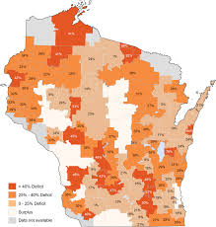
Creating the Clinical Workforce We Need
Scott Shipman, MD, MPH
Director of Clinical Innovations
Director of Primary Care Initiatives and Workforce Analysis
Association of American Medical Colleges
2018 Wisconsin Council on Medical Education and Workforce Summit

Slide 2
Disclosure:
No financial relationships to disclose
Opinions stated are my own, not necessarily those of my employer (or anyone else, for that matter)

Slide 3
Appreciation:
Workforce studies team at AAMC
Da’Shia Davis
Michael Dill
Kara Fisher
Sarah Hampton
Xiaochu Hu
Karen Jones

Slide 4
Overview
Projections, forecasting and other forms of educated guesswork on physician adequacy
Workforce trends and capacity, Part I: Meeting the healthcare needs of patients
Workforce trends and capacity, Part II: Meeting the training needs of the next generation

Slide 5
Why consider physician supply?
As a means to understand access to care
Only one of many factors influencing access to care
Supply of physicians
Availability for patients
Health outcomes

Slide 6






Prioritizing limited funding for efforts to improve access to the means to maximize health
More doctors, NPs, PAs?
Public health?
Community health workers?
Education?
Behavioral/ mental health workers?

Slide 7
Relationship between a region’s primary care supply (2006) and the percent of Medicare beneficiaries having at least one ambulatory visit to a primary care physician (2003-07)
95.0
85.0
% with at least one ambulatory visit to a
primary care physician
75.0
65.0
55.0
30.0
50.0
70.0
90.0
110.0
130.0
Primary care physicians per 100,000 residents

Slide 8
Relationship between a region’s primary care supply (2006) and the percent of Medicare beneficiaries having at least one ambulatory visit to a primary care physician (2003-07)
95.0
85.0
% with at least one ambulatory visit to a
primary care physician
75.0
(Theoretical)
65.0
55.0
30.0
50.0
70.0
90.0
110.0
130.0
Primary care physicians per 100,000 residents

Slide 9
Relationship between a region’s primary care supply (2006) and the percent of Medicare beneficiaries having at least one ambulatory visit to a primary care physician (2003-07) – Regions are Hospital Referral Regions (HRR)
95.0
85.0
% with at least one ambulatory visit to a
primary care physician
75.0
65.0
R²
= 0.07
55.0
30.0
50.0
70.0
90.0
110.0
130.0
Primary care physicians per 100,000 residents

Slide 10
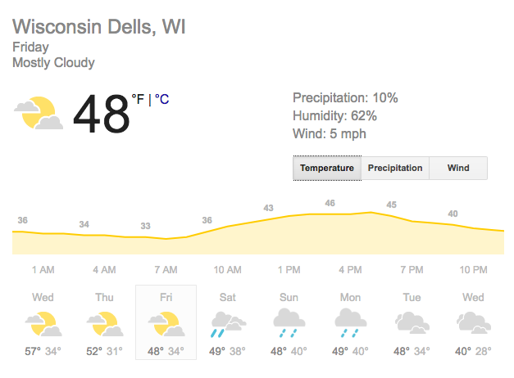
Forecasting the Workforce vs. Forecasting the Weather
Information is intended to aid in planning

Slide 11


Forecasting the Workforce vs. Forecasting an empty tank of gas
Information is intended to spur action

Slide 12
Policies and programs seeking to impact the physician workforce
Strategically placed medical school branch campus expansion
Title VII
AHEC
NHSC
State loan repayment programs
MedPAC interest in primary care
Teaching Health Centers
Health is Primary Campaign
SGIM: Proud to be GIM
Conrad 30
State-funded GME expansion
-Focus is typically on impacting aggregate supply,
geographic distribution and/or specialty mix-

Slide 13

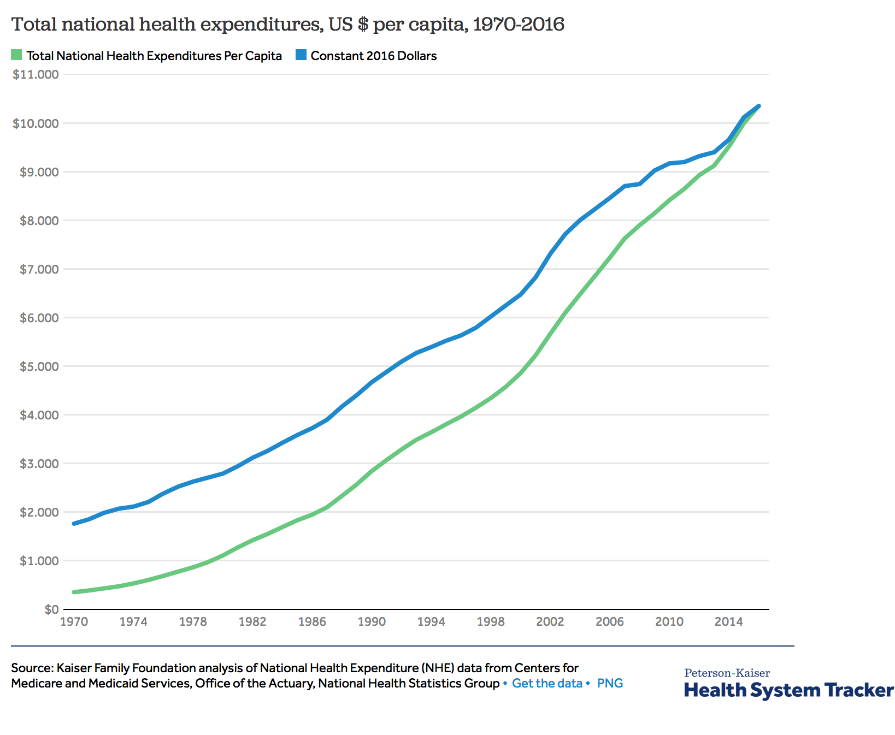
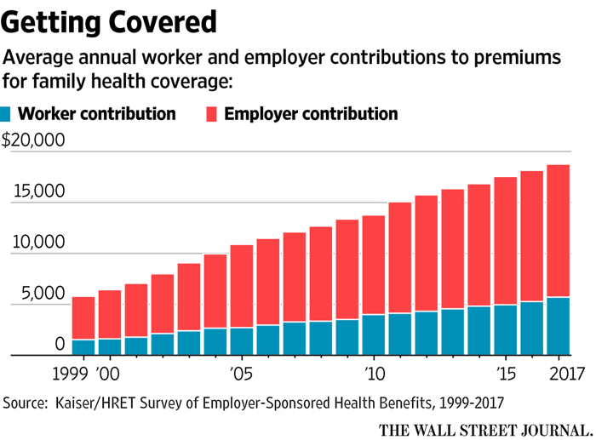

Slide 14
Exploring the adequacy of the national physician workforce

Slide 15
AAMC Projections, 2018: Growing shortage of physicians projected through 2030
75th percentile
2030
Range
25th percentile
Source: AAMC, 2018 Update: Complexities of Physician Supply and Demand: Projections from 2016 to 2030.
Notes:
Not that far off

Slide 16
Projected physician shortages in 2030, by specialty group
Source: AAMC, 2018 Update: Complexities of Physician Supply and Demand: Projections from 2016 to 2030.
Notes:
ALL SHORTAGE - VARIATIONS
PSYCH
--
PERCENTILES NOT SAME, SOME SUBSTITUTION
---
Primary care consists of family medicine, general internal medicine, general pediatrics, and geriatric medicine. Medical specialties consist of allergy & immunology, cardiology, critical care, dermatology, endocrinology, gastroenterology, hematology & oncology, infectious diseases, neonatal & perinatal medicine, nephrology, pulmonology, and rheumatology. Surgical specialties consist of general surgery, colorectal surgery, neurological surgery, obstetrics & gynecology, ophthalmology, orthopedic surgery, otolaryngology, plastic surgery, thoracic surgery, urology, vascular surgery, and other surgical specialties. The Other Specialties category consists of anesthesiology, emergency medicine, neurology, pathology, physical medicine & rehabilitation, psychiatry, radiology, and all other specialties. For the 2016 report, Hospitalists trained in adult primary care are modeled as their own category and have been moved out of the Primary Care category. Hospitalists trained in non-primary care specialties are modeled within their trained specialty.

Slide 17
Forecasting workforce adequacy on the basis of historical health care utilization
Consider the ACA impact from a workforce perspective…
Millions newly insured
Utilization
Physician demand
Bend the cost curve
Efficiency
Cost sharing
Physician demand

Slide 18


…and add in uncertainties of our current political era
Consider the Affordable Care Act from a workforce perspective
Millions newly insured?
Utilization
Physician demand
Bend the cost curve
Efficiency
Cost sharing
Physician demand

Slide 19
The Physician Workforce is Aging
Notes:
Shifting to demographics of the workforce
What we do know: Number of physicians hitting age 65 will nearly double over the next decade

Slide 20
On the other end of the career spectrum: family/personal time matters a lot
 | % Ranking as Very Important
Time for family/personal life | 71%
Adequate support staff and services | 43%
Long term income potential | 42%
Practice income | 39%
Flexible scheduling | 37%
Health insurance coverage | 35%
No or very limited on-call | 31%
Adequate patient volume | 30%
Opportunity to advance professionally | 28%
Important Factors in a Desirable Practice for Physicians < 50 years of age
Source: AAMC/AMA Survey of Physicians Under 50, 2006
Notes:
These factors were important for both men and women, but women especially likely to rate family and personal time highly.

Slide 21
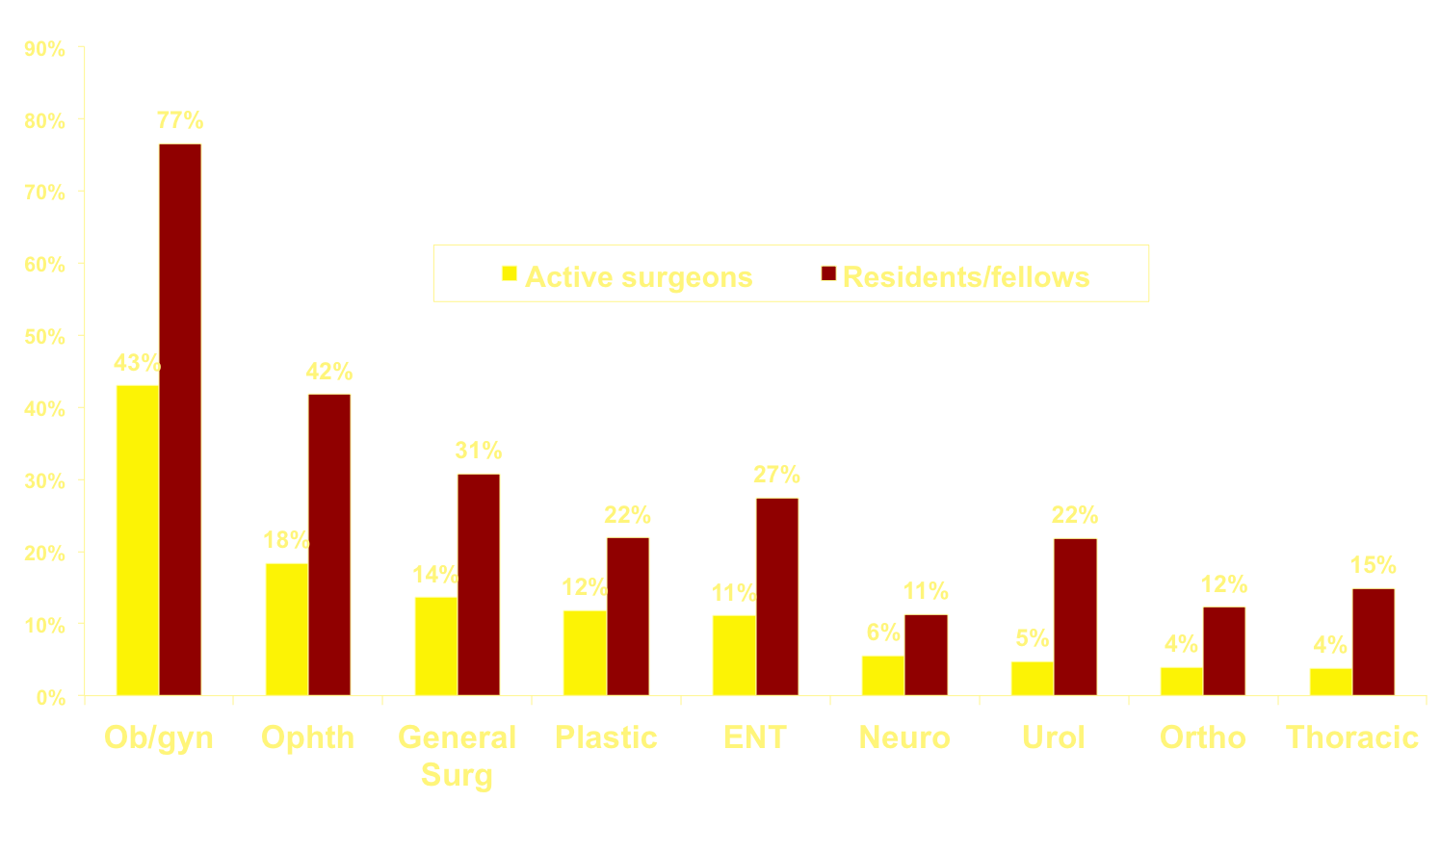
Women in Medicine: Not Just Primary Care
% Women Comprising the Surgical Fields
Notes:
Most know that women make up half of our medical students, and they are significantly more likely than men to enter primary care. (Pediatrics example: 3 in 4 residents is a woman. Only 1 in 4 men in peds residency express an interest in primary care, as compared to 3 in 4 women. . .)
Less often considered is the information shown on this slide: Traditionally, men made up the vast majority of those entering surgical fields. . .while women are still a minority, they are no longer a rarity, and tomorrow’s workforce will include a substantial proportional of women.

Slide 22
Gender- and Family-related factors
Source: U.S. Census and American Community Survey,
Unpublished analyses by the AAMC Center for Workforce Studies

Slide 23
Managing a physician shortage: what to do?
Train more
Find someone else
Lose fewer
Waste less

Slide 24
Managing a physician shortage: what to do?
Train more
Medical Schools have gotten the message to “train more”. . .

Slide 25
Overall MD & DO first year enrollment is projected to grow 59% between 2002 and 2021
27 new MD granting Medical schools
Notes:
Likely an underestimate of DO enrollment
From 19 programs in 2002 to 49 programs in 2017 including remote sites & branch campuses
From 19 programs in 2002 to 39 programs in 2017 excluding remote sites.
From 19 programs in 2002 to 34 programs in 2017 excluding both remote sites and branch campuses.

Slide 26
How could medical school expansion influence the future workforce?
Student self-report from AAMC Matriculating Student Questionnaire
 | % of Respondents
 | 1999-2001 | 2009-2011
Plan to work in underserved area | 21 | 24
Plan to work primarily with minority population | 14 | 15
Plan to go into Primary Care | 48 | 38
Practice in a rural town/ small city | 14 | 9
Practice setting undecided | 19 | 22
Shipman et al, Acad Med Dec 2013

Slide 27
Changes in Attributes of Medical School Matriculants
Matriculating student data from MD school applications (AMCAS)
 | % of Matricultants
 | 1999-2001 | 2009-2011
Rural Birth County | 6.7 | 4.1
Minority (Black/AA, Hispanic, Indian/American/PI Native) | 14.3 | 16.1
Parental Education: PhD, MD/DO, DDS | 29.1 | 36.8
Less than college degree | 18.8 | 13.3
Mean Parent income, 2011 dollars | $159, 500 | $172,000
Shipman et al, Acad Med Dec 2013

Slide 28
Matriculants from rural backgrounds have steadily declined
38% decline
Source: AAMC data (AMCAS)
-Not for circulation, manuscript in process -

Slide 29
Logistic Regression for Acceptance to Medical School
 | Odds Ratio | 95% Conf Interval | RR*
Female | 1.55 | (1.53 – 1.57) | 1.17
Rural | 1.34 | (1.31 – 1.38) | 1.12
URM | 4.56 | (4.47 – 4.66) | 1.76
GPA above median | 3.72 | (3.67 – 3.77) | 1.70
Also controlled for: MCAT score, Parental education level, Age, Year of application
*Poisson regression model with robust error estimation
-Not for circulation, manuscript in process -

Slide 30
Managing a physician shortage: what to do?
Find someone else
Lose fewer
Waste less

Slide 31
Finding someone else:
Pipelines of PAs & NPs are growing rapidly
 | 2007 | 2015-2016
PA programs | 134 | 209
DNP programs | 53 | 313
Source: PAEA Program Reports; AACN Correspondence.
Notes:
While the number of MD-granting school matriculants has grown by 29% from 2002–2003 to 2017–2018, the number of DO-granting school matriculants has grown by 163%. From 2002–2003 to 2016–2017, the total enrollment in master’s and doctoral nursing programs increased 292% and the doctor of nursing practice was established. For PAs, first-year enrollment grew 154% from 2002–2003 to 2015–2016.

Slide 32
Clinical Redesign: An Essential Means to Enhance Workforce Capacity
Team-based care: more efficient care, more comprehensive care, more patient-centered care
Clinical workflow optimization: less waste of clinician and staff time
Enhanced medical neighborhood: right-sizing referral rates, support comprehensive primary care, less fragmentation through better coordination of care between PCPs and specialists
Role of telehealth: convenience (a two-edged sword?), better access for remote populations, redefining health care?

Slide 33

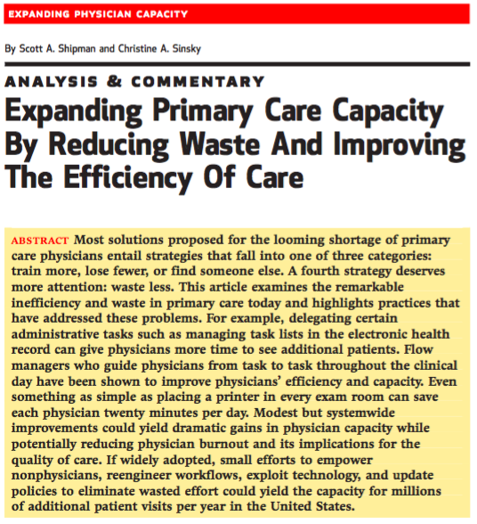
Waste less:
If just half of all physicians saved 30 minutes a day and spent that time with one additional patient per day, 15-20 million more physician visits could take place each year.

Slide 34





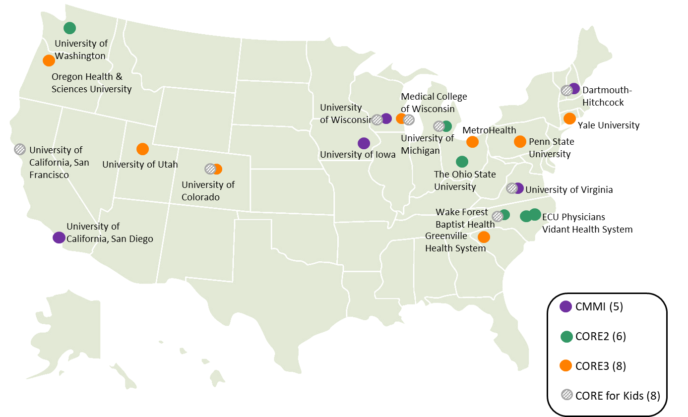
27 AMCs across 15 states participating as of July 2018
More than 3000 PCPs participating
More than 3 million patients able to benefit
>1,000 eConsults completed each month across participating AMCs
19% reduction in referral rates among PCPs¹
2019 Physician Fee Schedule: PCPs and Specialists will be paid for eConsults
¹Comparing high vs. low eConsult users
Learn more at aamc.org/projectcore

Slide 35
Workforce capacity for meeting training needs of professional learners

Slide 36
Growing concern nationally re: clinical training opportunities for MD students
Source: AAMC 2017 Medical School Enrollment Survey Report
Notes:
SITES & PRECEPTORS

Slide 37
Dean’s report growing competition especially from DO, NP & PA programs
2009
2017
2009
2017
2009
2017
Source: AAMC 2017 Medical School Enrollment Survey Report
Notes:
FACULTY – COMPETITION - PAY

Slide 38

A state-based effort to enhance clinical placements
Insights from NH on expanding, coordinating, and aligning clinical training with workforce needs
Goals:
Create a rational system to link students with sites
  Align interests of students and needs of sites
  Prioritize NH background, rural background of students in high need areas
Simplify, standardize process of taking students for the preceptors and sites
Level the playing field for programs, prioritizing in-state programs
NH

Slide 39
A state-based effort to enhance clinical placements
Insights from NH on expanding, coordinating, and aligning clinical training with workforce needs
Lessons learned:
Need a neutral convener
Training programs: have’s vs. have-not’s; concerns about current staffing in place for placements
Preceptors: Eager for a more coordinated system; decisions are increasingly out of providers hands
Students: NH-based placements not perceived as a problem, or so desperate just to obtain any placement with enough lead time that this was not a priority
Funding over time: need a source to establish and maintain
NH

Slide 40

STFM-led Initiative to Expand Size and Quality of Clinical Preceptor Pool
Tactic 1: Work with CMS to revise student documentation guidelines
Tactic 2: Integrate interprofessional/interdisciplinary education into ambulatory primary care settings
Tactic 3: Develop standardized onboarding process for students and preceptors & Integrate students into the work of ambulatory primary care settings in useful and authentic ways
Tactic 4: Develop educational collaboratives across departments, specialties, professions, and institutions to improve administrative efficiencies
Tactic 5: Promote productivity incentive plans that include teaching & develop a culture of teaching in clinical settings
http://www.stfm.org/Resources/ResourcesforMedicalSchools/PreceptorExpansionInitiative

Slide 41
What’s coming at the interface of clinical redesign and workforce studies at AAMC?
Exploring the workforce implications of telehealth
Further efforts to promote and scale Project CORE, promoting more efficient use of specialists and more comprehensive care in primary care
Convener for AMCs participating in APMs
Forthcoming report (third in a series on high functioning primary care) highlighting effective models of population health in primary care GME programs

Slide 42
Q
A
&
THANK YOU!
Scott Shipman, MD, MPH
AAMC Director of Clinical Innovations
sshipman@aamc.org

